Slide 1
Morse Code Trainer
By: Ayin Pitman, Lorraine Graham, Mahnoor Ghani, and Vugar Amirov
Notes:
Everyone

Slide 2
TABLE OF CONTENTS
01
02
03
Reflection
Motivation + Functionality
Specification + Diagrams, and Code
Why we chose the project we chose, and how it works
More detailed explanations and diagrams of our system
What our project did well, and future improvements
Notes:
Ayin - 30 seconds

Slide 3
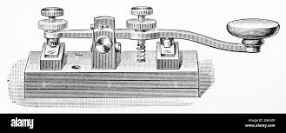
01. Motivation
Create a simple translator that can continue the legacy of Morse Code and bring it’s accessible features to a wider audience
The real-time translation creates an approachable learning environment for those new to Morse Code. It allows users to practice as the timing can be difficult to master.
The fully tactile interface allows this tool to be used despite various environmental disturbances
Notes:
Ayin - 30 seconds

Slide 4
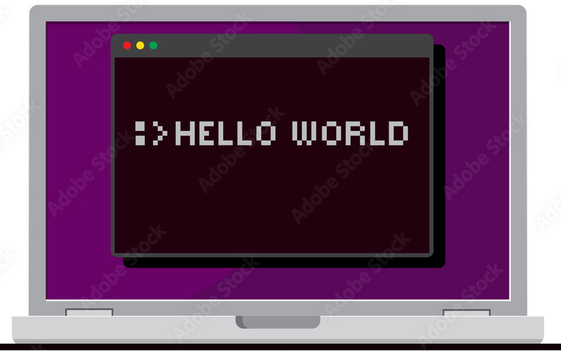
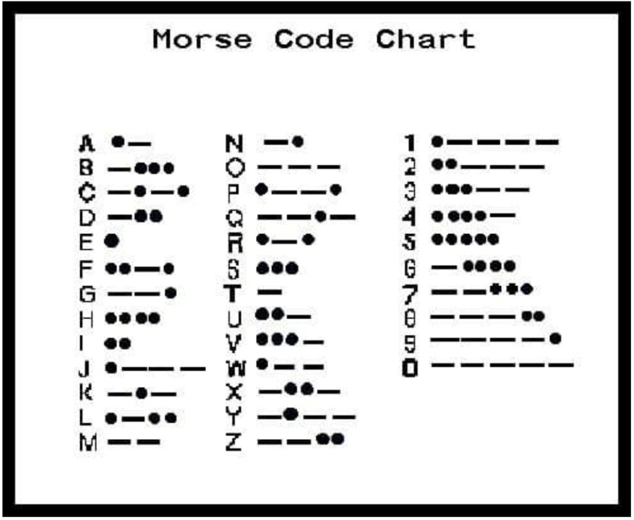
01. Functionality
Real Time Translation
Text Display
Our project’s main goal is to translate from Morse Code into written english as you type!
and display the translated content onto a display for easy readability.
Notes:
Ayin - 30 seconds

Slide 5
02. Specifications
- Process human input into Morse Code using one button
- Translate Morse Code into written English
- Have translated English appear on the display as it is being translated
- Include a delete button that deletes the last translated character
- Include a reset button
- Implement correct timing for Morse Code (dots, dashes, spaces, etc.)
Notes:
Ayin - 30 seconds

Slide 6
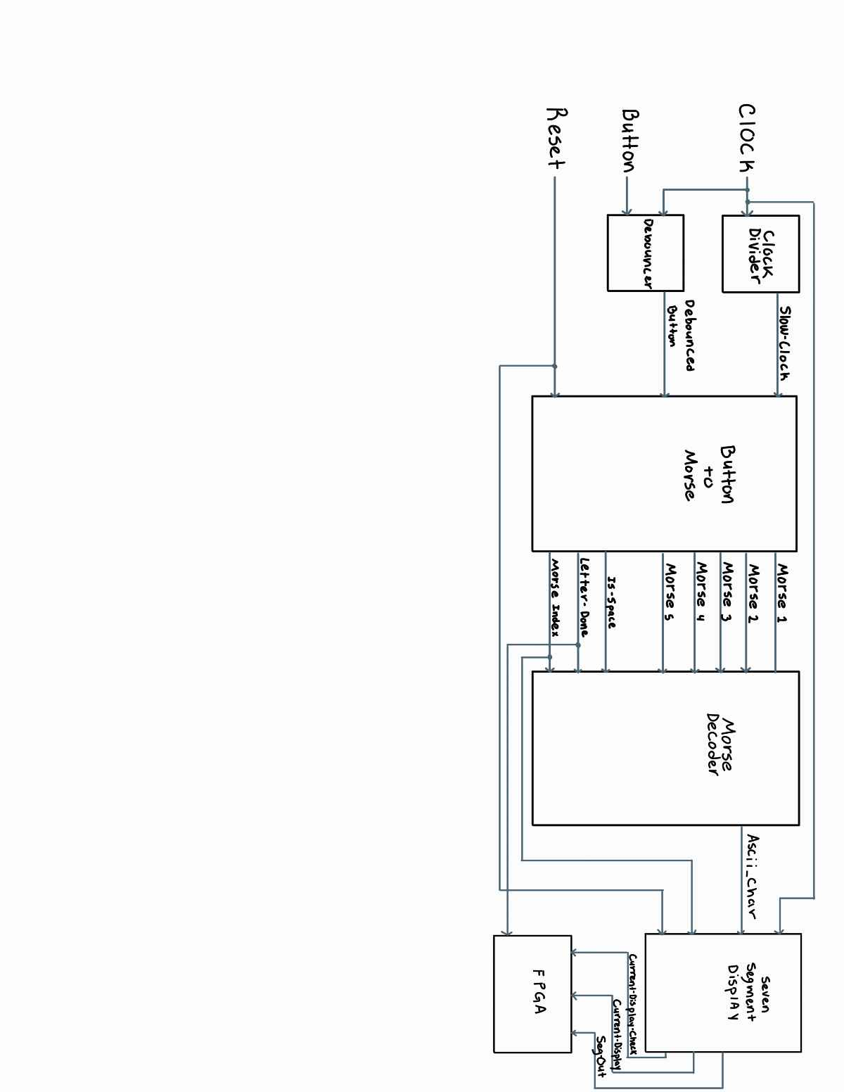
02. Block Diagram
Notes:
Mahnoor - 1 minute

Slide 7
Button_to_morse
and morse_decoder modules
02. Code Snippets

Slide 8
Dot or Dash?
if (counter >= one_time_unit) begin
// Determine dot or dash based on press duration
if (counter >= three_time_units) begin
case (morse_index) // Dash
3'b000: latched_morse[0] <= 2'b10;
3'b001: latched_morse[1] <= 2'b10;
3'b010: latched_morse[2] <= 2'b10;
3'b011: latched_morse[3] <= 2'b10;
3'b100: latched_morse[4] <= 2'b10;
default begin
latched_morse[0] <= 2'b00; latched_morse[1] <= 2'b00; latched_morse[2] <= 2'b00;
latched_morse[3] <= 2'b00; latched_morse[4] <= 2'b00;
end
endcase
end else begin
case (morse_index) // Dot
3'b000: latched_morse[0] <= 2'b01;
3'b001: latched_morse[1] <= 2'b01;
3'b010: latched_morse[2] <= 2'b01;
3'b011: latched_morse[3] <= 2'b01;
3'b100: latched_morse[4] <= 2'b01;
default begin
latched_morse[0] <= 2'b00; latched_morse[1] <= 2'b00; latched_morse[2] <= 2'b00;
latched_morse[3] <= 2'b00; latched_morse[4] <= 2'b00;
end
endcase
end
end
The code determines if the user input is a dot or dash depending on timing.
If held for a minimum of one clock cycle, the code detects a dot. If held for a minimum of 3 clock cycles, the code detects a dash.
Once the symbol is correctly identified, the index is incremented so it can detect the next symbol.
Notes:
Lorraine - 1 minute

Slide 9
User Input → Morse Code
if (inactivity_counter >= three_time_units && !latched_done && !is_space) begin
morse_one <= latched_morse[0];
morse_two <= latched_morse[1];
morse_three <= latched_morse[2];
morse_four <= latched_morse[3];
morse_five <= latched_morse[4];
letter_done <= 1; // Detects finished letter
latched_done <= 1; // Detects when latching is done
. . .
if (inactivity_counter >= seven_time_units && latched_done) begin
is_space <= 1; // Set is_space signal high
letter_done <= 0; // Reset letter_done to avoid processing new symbols
morse_index <= 0;
latched_morse[0] <= 2'b00;
latched_morse[1] <= 2'b00;
latched_morse[2] <= 2'b00;
latched_morse[3] <= 2'b00;
latched_morse[4] <= 2'b00;
end
If button is inactive for at least three time units, code detects that the letter is done
If inactive for at least seven units, a space is detected and index is reset to allow for the user to input a new character
Notes:
Lorraine - 1 minute

Slide 10
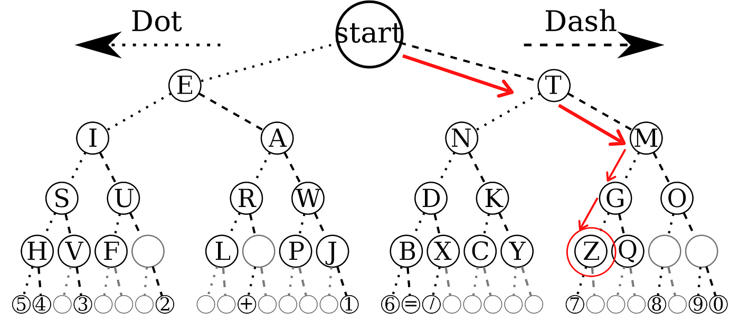
Dots/Dashes to Ascii Binary
if (is_space) begin
ascii_char = " ";
last_valid_char = ascii_char;
end else if (letter_done) begin
// Start traversal of binary tree
if (morse_one == 2'b01) begin // Dot (E branch)
if (morse_two == 2'b01) begin // Dot (I branch)
if (morse_three == 2'b01) begin // Dot (S branch)
if (morse_four == 2'b01) begin // Dot (H branch)
if (morse_five == 2'b01) begin // Dot
ascii_char = "5"; // ......
end else if (morse_five == 2'b10) ascii_char = "4";
ascii_char = "A"; → . -
ascii_char = "B"; → - . . .
ascii_char = "C"; → - . - .
Using IF statements to implement the binary tree
Any letter or number can have maximum of 5 dots or dashes therefore the code has 5 variables
After finding the correct letter, it returns its ASCII value
Notes:
Vugar - 1 minute

Slide 11

Video
Notes:
Video - 30 seconds

Slide 12

03. Successes
1. Only one button used for both dot and dash inputs
2. Mapping morse code to character is correct
3. All modules work together in the top module
4. 7-Segment display properly displays letters
5. Clock divider properly changes unit time
Notes:
Mahnoor 1 minute

Slide 13
03. Failures
How We Would Improve
(with more time)
1. UART + VGA display
2. Didn’t accomplish adding the delete button
3. Space is not yet functioning on the display.
Implementing the off-FPGA display
Implementing the delete button
Adding dynamic error correction
Adding high contrast modes for display
Adding text to speech functionality
Notes:
Vugar 1.5 minutes

Slide 14
03. What we wish to accomplish
Space is implemented after 3 time units of button inactivity
Switch inputs to change timing of clock
currently one clock speed of 4Hz (1 unit = ¼ s))
Notes:
Lorraine - 15 seconds

Slide 15
Questions?
Thanks for listening!

